Slide 1
Test Cases
Revision 20 - OOP

Slide 2
ReadME
Before running the EA live, make sure the EA functions well. Cause directory transfer may cause file being corrupt/damage.
Compile the program if necessary.
On strategy tester, under input tab, Load the defaults input (GOLD_ORB\Input), or manually input it on.
Run the EA with the same inputs on backtest. The resulting graph from the ff page must be the same.

Slide 3
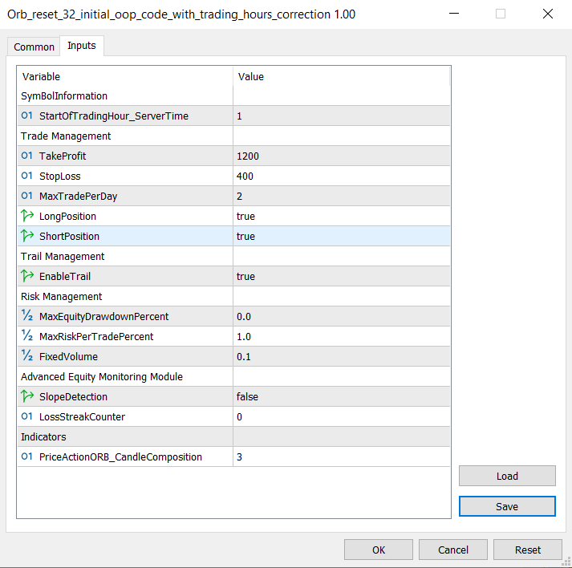
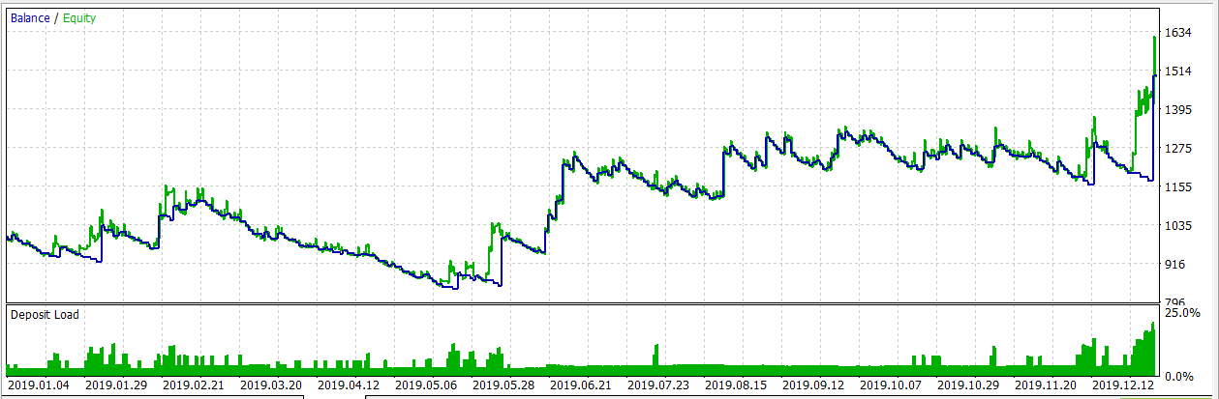
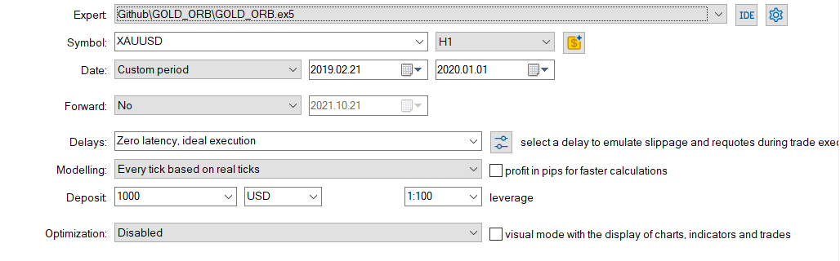

Default Input

